Slide 1
Top Bar
Sidemenu
Content

Slide 2
Dashboard Template
Frontend Template
Result

Slide 3
Dashboard Template
Frontend Template
Result

Slide 4
Dashboard Template
Frontend Template
Result

Slide 5
Dashboard Template
Frontend Template
Result
<title>
{% block title %}
SB Admin 2 – Dashboard
{% endblock title %}
</title>
{% extends 'site/sb-admin-2/base.html' %}
{% block title %}
Dashboard: with Django and Bootstrap
{% endblock title %}
<title>
Dashboard: with Django and Bootstrap
</title>

Slide 6
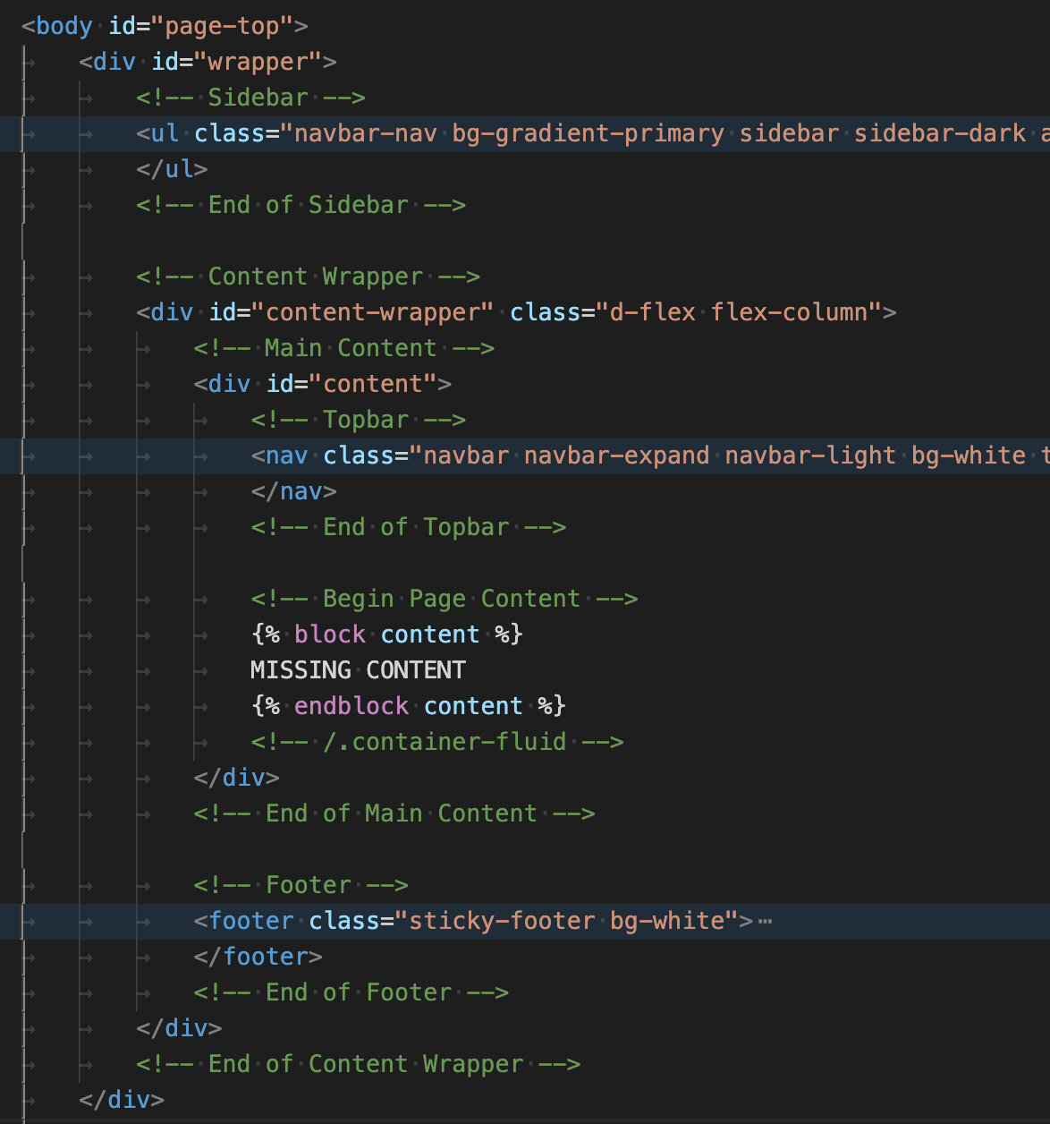
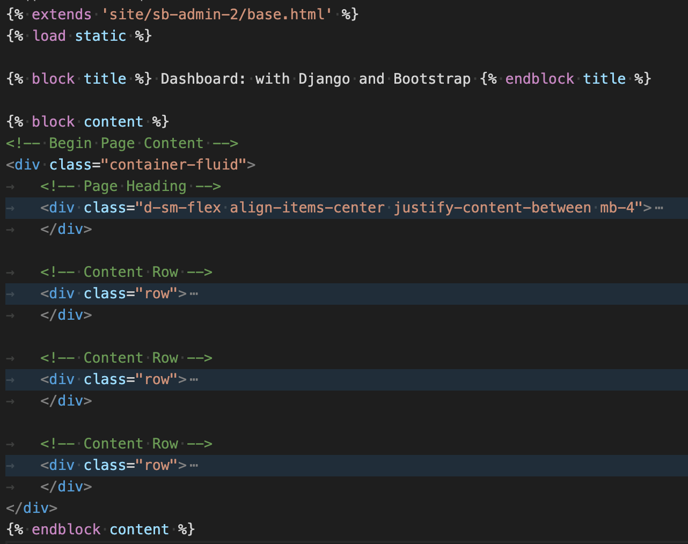
Dashboard Template
Frontend Template

